Slide 1

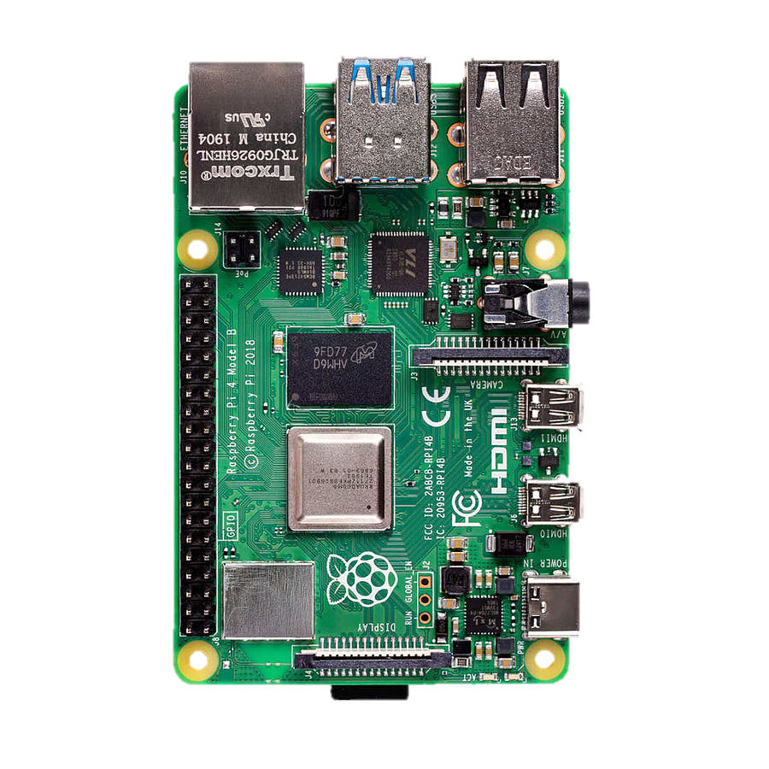
UWB Sensing
Exploring the Mechanism &
Experiment-Driven Insights
Presented by: Justas Zubavičius, Naglis Šuliokas, and Patrikas Merkelis

Slide 2

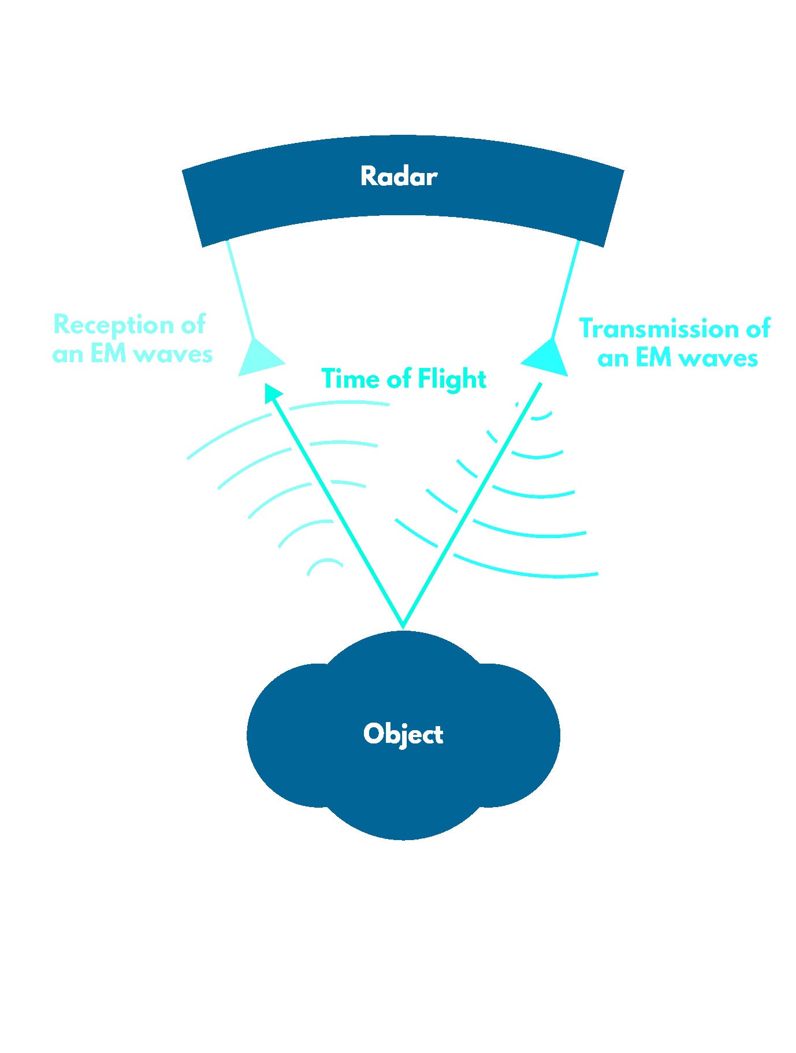
Mechanism of UWB sensing
Ultra-Short Pulses
Time-of-Flight Measurement
Nanosecond-long pulses spread across a wide frequency spectrum and bounces back
Calculates precise distances by measuring pulse travel times
Spread Spectrum Technique
Multipath Processing
Utilizes algorithms to decode reflected signals for accurate environmental mapping
Ensures minimal interference and maximizes signal integrity
Diagram of UWB Sensing Mechanism
Notes:
In our exploration of Ultra-Wideband (UWB) technology, it is essential to understand the fundamental mechanism behind UWB sensing, a pivotal aspect that drives its myriad applications. UWB is renowned for its ability to provide precise location data and detailed environmental mapping, all thanks to its unique method of pulse generation and reception. Let’s delve deeper into this sophisticated technology.
(->)Ultra-Wideband Pulse Transmission: UWB technology distinguishes itself by transmitting extremely short pulses of radio energy across a broad frequency spectrum. These pulses are typically only a few nanoseconds long, which allows UWB systems to emit a vast number of pulses per second. The advantage of such brief pulses is twofold: they allow for the resolution of tiny distance changes, and they minimize the chance of interference with other signals in the environment, thus providing cleaner data capture.
(->)Time-of-Flight (ToF) Measurement: At the core of UWB sensing lies the principle of Time-of-Flight (ToF). ToF is calculated by measuring the time it takes for a UWB pulse to travel from the transmitter to an object and back to the receiver. The distance to the object is directly proportional to this travel time. Given that radio waves travel at the speed of light, even minute differences in ToF can be used to calculate changes in position with high precision. This method enables UWB systems to detect object locations, movements, and even subtle changes in the layout of an environment.
(->)Spread Spectrum Technique: The UWB’s transmission across a wide range of frequencies also involves a technique known as spread spectrum. This technique spreads the radio energy emitted by UWB over a wide frequency band, reducing the power density and the potential for interference with other devices. The spread spectrum makes UWB highly resilient to signal interference and jamming, which is particularly important in crowded electromagnetic environments.
(->)Multipath and Signal Processing: After a UWB pulse is transmitted, it can reflect off various surfaces before returning to the receiver. This phenomenon, known as multipath, can complicate the signal processing but also provides richer information about the environment. UWB systems utilize sophisticated algorithms to interpret these multipath reflections, which can help delineate the contours of a room, identify obstacles, and even track moving objects with high fidelity. Advanced signal processing techniques decode the complex signal patterns to distinguish between direct paths and reflections, enhancing the accuracy and reliability of the data.
The practical implications of UWB's sensing mechanism are vast. In real-world applications, the ability to accurately track the location of objects or individuals with minimal latency and high precision is invaluable in industries such as logistics, automation, security, and healthcare. Moreover, UWB technology is crucial for applications requiring secure communications, as its signals are difficult to detect and intercept due to their low power levels and widespectrum.

Slide 3
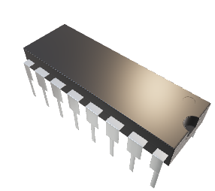
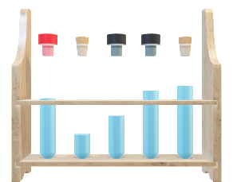
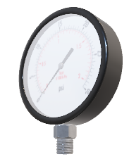
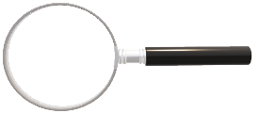
1st Experiment: Motion Detection
Hardware Components
Radar Specifications
Experiment Layout and Workflow
Processing Techniques and Analysis
Raspberry Pi: for initial data storage and preprocessing before export to PC
Radar Module
PC: for further data processing and analysis
Center Frequency (fc): 7.29 GHz
Bandwidth (B): 2.5 GHz
Sampling Rate (fs): 23.328 GHz
Pulse Repetition Frequency (fF): 30 Hz
Initialization
Operation:
Data Collection
Data Analysis
Reflection Handling: Extract and reduce stationary reflections
Signal Enhancement: Envelope extraction and motion feature enhancement
Radar Operation: 1min
Radar Range: 5m
Activity: Subject walks forward and back
Notes:
Building upon our understanding of the fundamental mechanisms of Ultra-Wideband (UWB) technology, let's examine how this technology is implemented and the practical implications of its sophisticated mechanisms in real-world applications.

Slide 4

1st Experiment: Motion Detection
Hardware Components
Radar Specifications
Experiment Layout and Workflow
Processing Techniques and Analysis
Raspberry Pi: for initial data storage and preprocessing before export to PC
Radar Module
PC: for further data processing and analysis
Center Frequency (fc): 7.29 GHz
Bandwidth (B): 2.5 GHz
Sampling Rate (fs): 23.328 GHz
Pulse Repetition Frequency (fF): 30 Hz
Initialization
Operation:
Data Collection
Data Analysis
Reflection Handling: Extract and reduce stationary reflections
Signal Enhancement: Envelope extraction and motion feature enhancement
Radar Operation: 1min
Radar Range: 5m
Activity: Subject walks forward and back
Notes:
Core Hardware Components: Our UWB system leverages essential hardware components to function efficiently. At the heart of our experimental setup, we have a Raspberry Pi that handles initial data storage and preprocessing. This is crucial because it allows for the immediate handling and reduction of data before it becomes too cumbersome. Additionally, a Personal Computer is used for more intensive data processing and detailed analysis, which is indispensable when dealing with the vast amounts of data generated by UWB sensing.

Slide 5
1st Experiment: Motion Detection
Hardware Components
Radar Specifications
Experiment Layout and Workflow
Processing Techniques and Analysis
Raspberry Pi: for initial data storage and preprocessing before export to PC
Radar Module
PC: for further data processing and analysis
Center Frequency (fc): 7.29 GHz
Bandwidth (B): 2.5 GHz
Sampling Rate (fs): 23.328 GHz
Pulse Repetition Frequency (fF): 30 Hz
Initialization
Operation:
Data Collection
Data Analysis
Reflection Handling: Extract and reduce stationary reflections
Signal Enhancement: Envelope extraction and motion feature enhancement
Radar Operation: 1min
Radar Range: 5m
Activity: Subject walks forward and back
Notes:
Radar System Specifications: To understand the capabilities of our UWB system, we must consider the radar's specifications. Our IR-UWB radar operates with a Center Frequency of 7.29 GHz, offering a Bandwidth of 2.5 GHz. This setup allows for high-resolution data capture, essential for detailed environmental mapping and precise location tracking. The Sampling Rate is an impressive 23.328 GHz, paired with a Pulse Repetition Frequency of 30 Hz, making our system highly responsive and capable of tracking rapid movements within the monitored environment.

Slide 6
1st Experiment: Motion Detection
Hardware Components
Radar Specifications
Experiment Layout and Workflow
Processing Techniques and Analysis
Raspberry Pi: for initial data storage and preprocessing before export to PC
Radar Module
PC: for further data processing and analysis
Center Frequency (fc): 7.29 GHz
Bandwidth (B): 2.5 GHz
Sampling Rate (fs): 23.328 GHz
Pulse Repetition Frequency (fF): 30 Hz
Initialization
Operation:
Data Collection
Data Analysis
Reflection Handling: Extract and reduce stationary reflections
Signal Enhancement: Envelope extraction and motion feature enhancement
Radar Operation: 1min
Radar Range: 5m
Activity: Subject walks forward and back
Notes:
Setup and Operational Workflow: The operational workflow of our UWB system starts with Initialization, where devices are powered and configured to begin data acquisition.
This step is followed by the Operation phase. In the Operation phase of our experiment, the radar was actively monitoring for one minute. During this time, our radar's effective range was up to 5 meters, which allowed us to capture detailed movement patterns. Our subject was instructed to move towards the sensor, reaching up to the maximum range, and then move back, mimicking potential real-life movement scenarios. This setup not only tests the radar's capacity to accurately track human motion but also its effectiveness over its entire operational range. By capturing this data, we can closely analyze how movements are detected and processed, giving us valuable insights into the system's performance and potential applications in environments where precise movement tracking is crucial.
Finally, the Data Analysis phase, where the collected data is processed and interpreted, transforming raw data into actionable insights. This workflow is streamlined to ensure efficiency and accuracy in data handling and analysis.

Slide 7
1st Experiment: Motion Detection
Hardware Components
Radar Specifications
Experiment Layout and Workflow
Processing Techniques and Analysis
Raspberry Pi: for initial data storage and preprocessing before export to PC
Radar Module
PC: for further data processing and analysis
Center Frequency (fc): 7.29 GHz
Bandwidth (B): 2.5 GHz
Sampling Rate (fs): 23.328 GHz
Pulse Repetition Frequency (fF): 30 Hz
Initialization
Operation:
Data Collection
Data Analysis
Reflection Handling: Extract and reduce stationary reflections
Signal Enhancement: Envelope extraction and motion feature enhancement
Radar Operation: 1min
Radar Range: 5m
Activity: Subject walks forward and back
Notes:
Processing Techniques and Analysis: The data processing techniques we employ are vital for enhancing the system's efficacy. We begin with the extraction of stationary reflections—this is where we distinguish between background static and relevant motions. Once identified, these reflections are subtracted from the overall dataset, thus enhancing the clarity and relevance of the motion data. Signal analysis is then performed, where envelope extraction techniques and motion feature enhancement algorithms are applied to further refine the data. These steps are crucial for accurately identifying and tracking the trajectory of moving objects.
Through these layers of technology—from hardware selection and system specifications to detailed data processing—we leverage the full power of UWB sensing. This approach not only ensures that we capture the most accurate and relevant data but also enables the application of UWB technology across various sectors, including logistics, automation, security, and healthcare. By understanding both the underlying technology and its practical implementation, we are better equipped to innovate and improve upon these systems, pushing the boundaries of what UWB can achieve in real-world scenarios.

Slide 8

Motion Detection: Multiple Interference Thresholding stationary object filter
Raw and Filtered 30th Frame Diagram

Slide 9
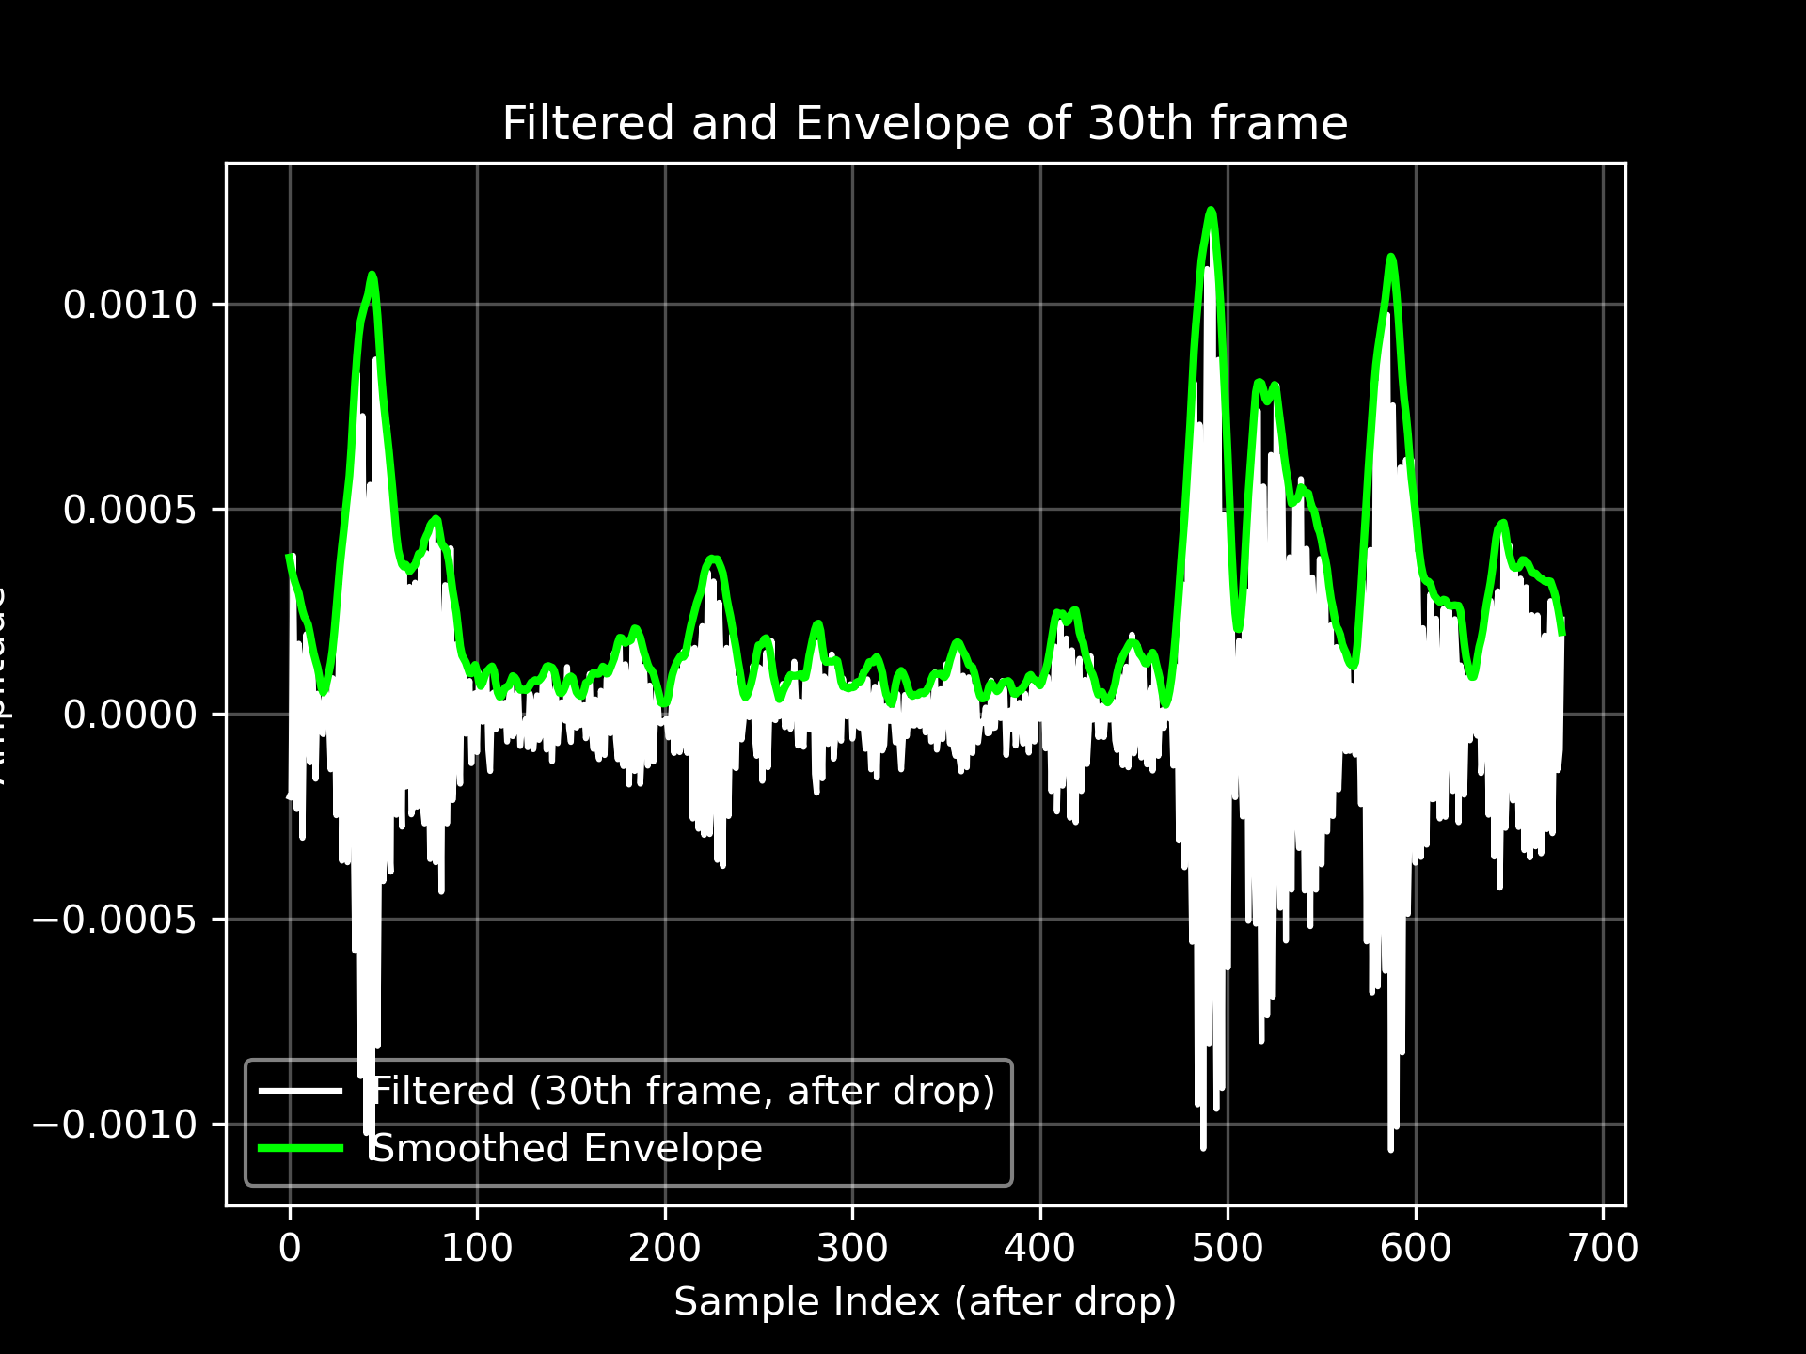
Motion Detection: Envelope extraction
Filtered and Envelope of 30th Frame

Slide 10
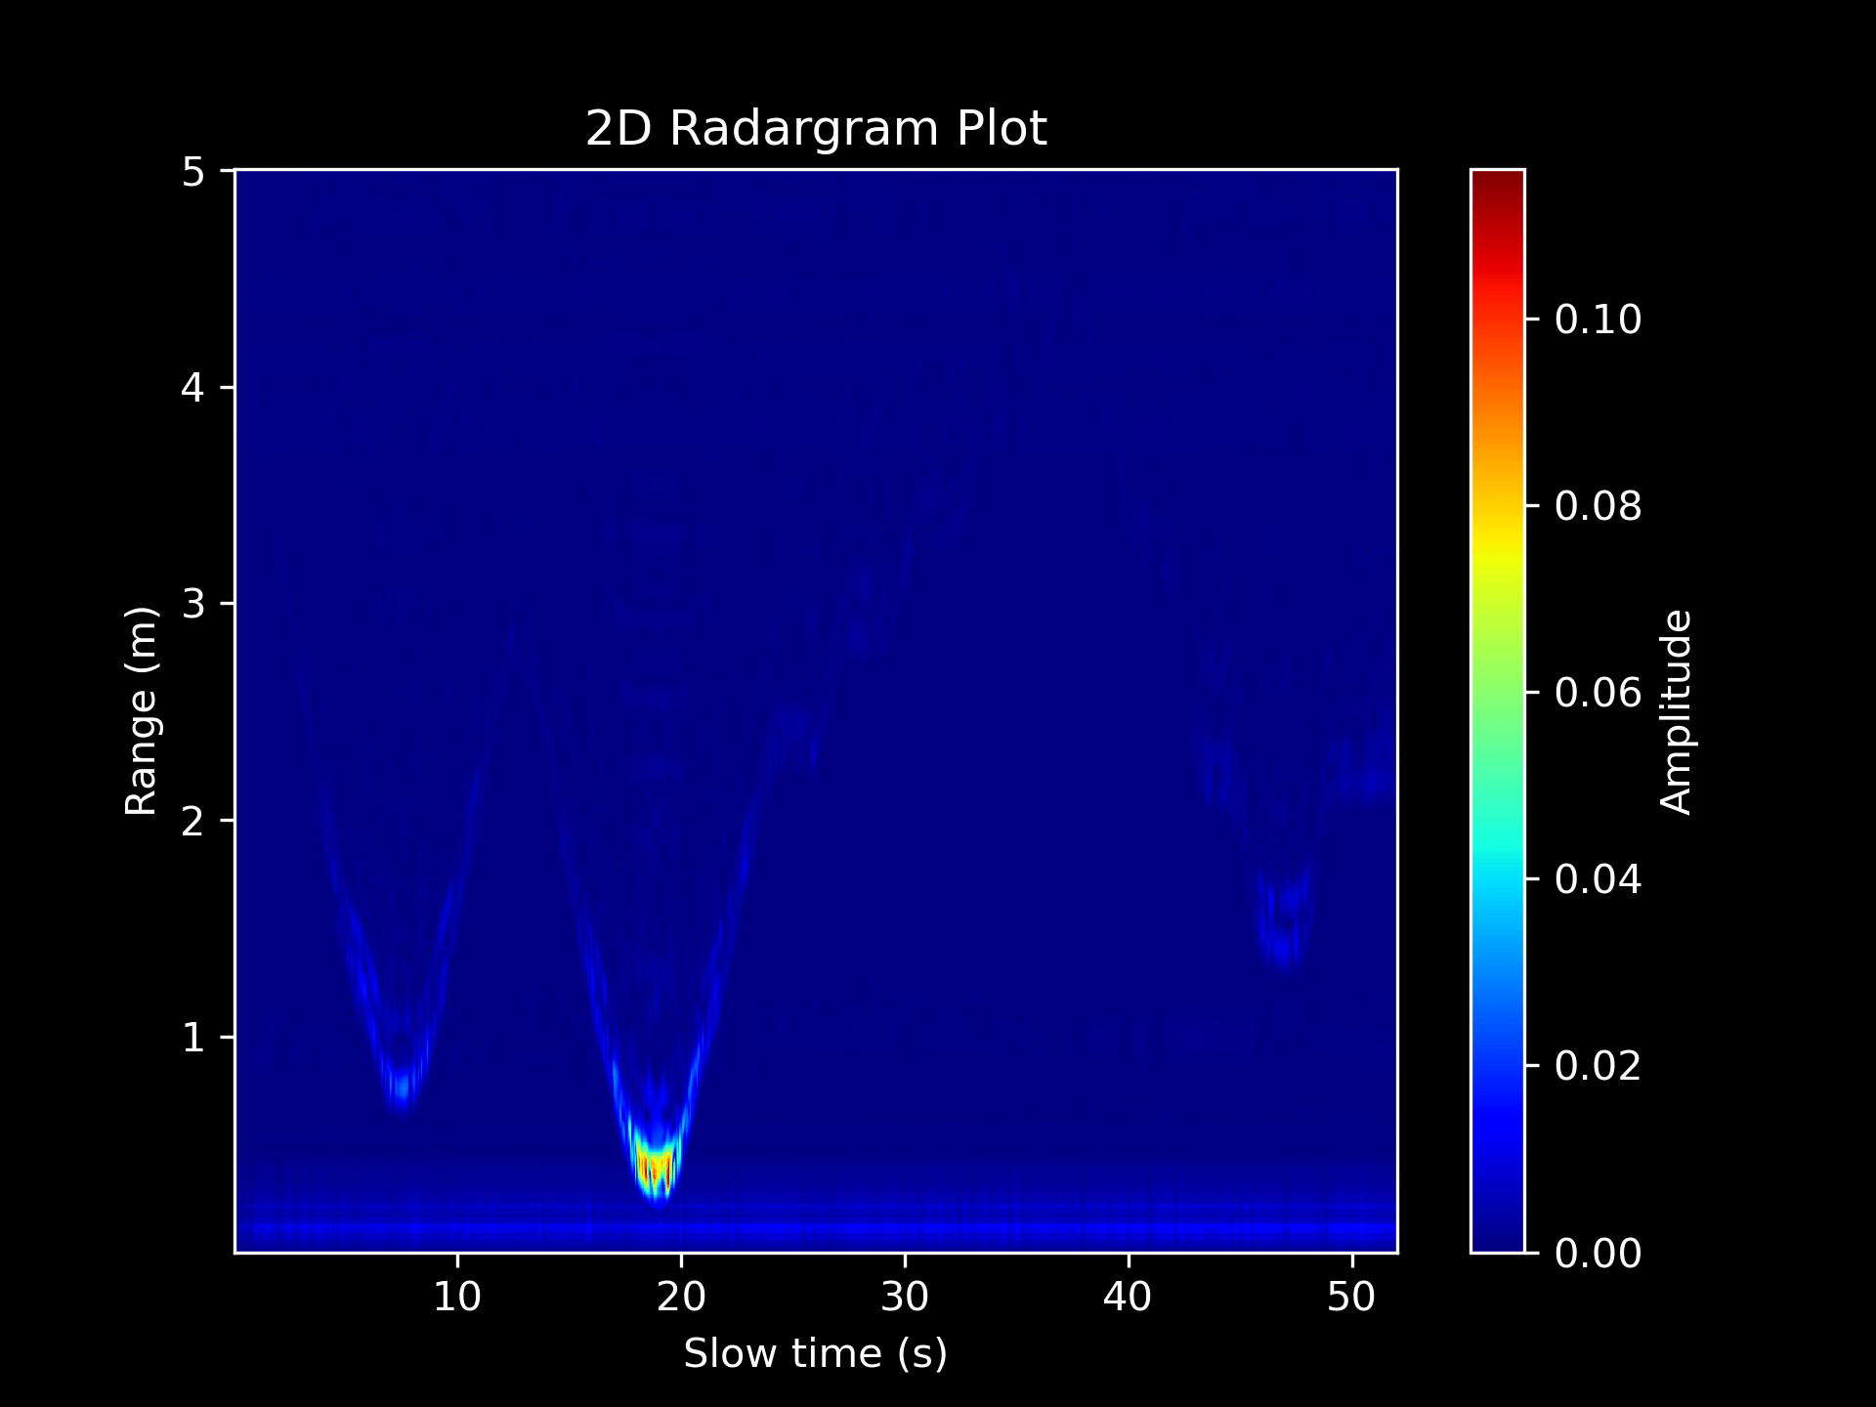
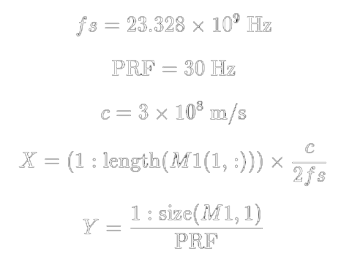
Motion Detection: Radargram (of envelopes)

Slide 11
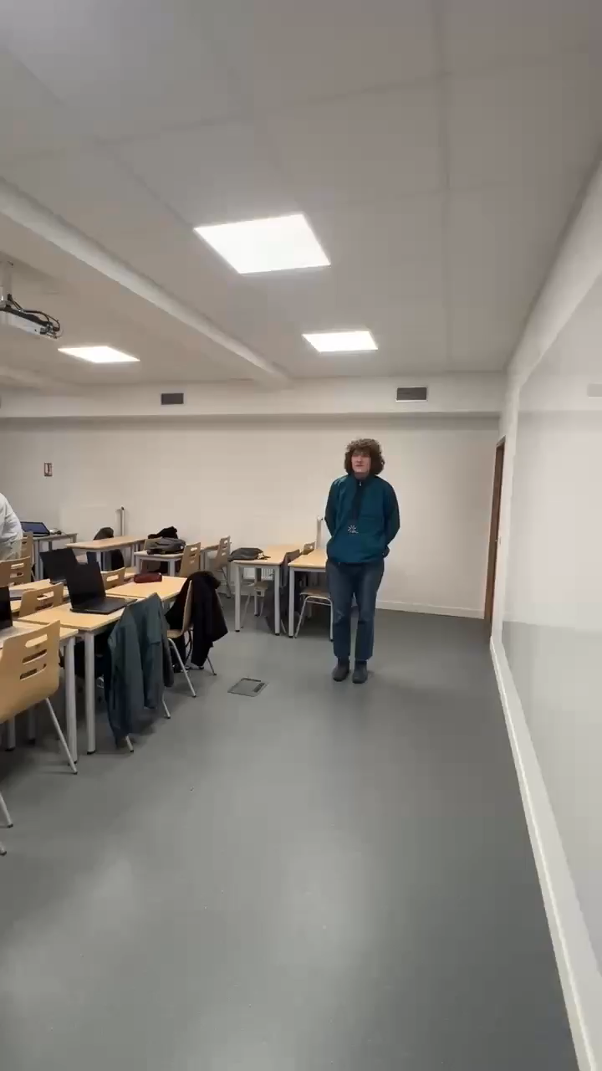
Motion Detection: Result comparison

Slide 12
2nd Experiment: Respiration Detection
Hardware Components
Radar Specifications
Experiment Layout and Workflow
Processing Techniques and Analysis
Raspberry Pi: for initial data storage and preprocessing before export to PC
Radar Module
PC: for further data processing and analysis
Center Frequency (fc): 7.29 GHz
Bandwidth (B): 2.5 GHz
Sampling Rate (fs): 23.328 GHz
Pulse Repetition Frequency (fF): 30 Hz
Initialization
Operation:
Data Collection
Data Analysis
Reflection Handling: Extract and reduce stationary reflections
Signal Enhancement: Envelope extraction and motion feature enhancement
Radar Operation: 1min
Radar Range: 3m
Activity: Subject breathes while seated

Slide 13
2nd Experiment: Respiration Detection
Hardware Components
Radar Specifications
Experiment Layout and Workflow
Processing Techniques and Analysis
Raspberry Pi: for initial data storage and preprocessing before export to PC
Radar Module
PC: for further data processing and analysis
Center Frequency (fc): 7.29 GHz
Bandwidth (B): 2.5 GHz
Sampling Rate (fs): 23.328 GHz
Pulse Repetition Frequency (fF): 30 Hz
Initialization
Operation:
Data Collection
Data Analysis
Reflection Handling: Extract and reduce stationary reflections
Signal Enhancement: Envelope extraction and motion feature enhancement
Radar Operation: 1min
Radar Range: 3m
Activity: Subject breathes while seated

Slide 14
2nd Experiment: Respiration Detection
Hardware Components
Radar Specifications
Experiment Layout and Workflow
Processing Techniques and Analysis
Raspberry Pi: for initial data storage and preprocessing before export to PC
Radar Module
PC: for further data processing and analysis
Center Frequency (fc): 7.29 GHz
Bandwidth (B): 2.5 GHz
Sampling Rate (fs): 23.328 GHz
Pulse Repetition Frequency (fF): 30 Hz
Initialization
Operation:
Data Collection
Data Analysis
Reflection Handling: Extract and reduce stationary reflections
Signal Enhancement: Envelope extraction and motion feature enhancement
Radar Operation: 1min
Radar Range: 3m
Activity: Subject breathes while seated

Slide 15
2nd Experiment: Respiration Detection
Hardware Components
Radar Specifications
Experiment Layout and Workflow
Processing Techniques and Analysis
Raspberry Pi: for initial data storage and preprocessing before export to PC
Radar Module
PC: for further data processing and analysis
Center Frequency (fc): 7.29 GHz
Bandwidth (B): 2.5 GHz
Sampling Rate (fs): 23.328 GHz
Pulse Repetition Frequency (fF): 30 Hz
Initialization
Operation:
Data Collection
Data Analysis
Reflection Handling: Extract and reduce stationary reflections
Signal Enhancement: Envelope extraction and motion feature enhancement
Radar Operation: 1min
Radar Range: 3m
Activity: Subject breathes while seated

Slide 16
2nd Experiment: Respiration Detection
Hardware Components
Radar Specifications
Experiment Layout and Workflow
Processing Techniques and Analysis
Raspberry Pi: for initial data storage and preprocessing before export to PC
Radar Module
PC: for further data processing and analysis
Center Frequency (fc): 7.29 GHz
Bandwidth (B): 2.5 GHz
Sampling Rate (fs): 23.328 GHz
Pulse Repetition Frequency (fF): 30 Hz
Initialization
Operation:
Data Collection
Data Analysis
Reflection Handling: Extract and reduce stationary reflections
Signal Enhancement: Envelope extraction and motion feature enhancement
Radar Operation: 1min
Radar Range: 3m
Activity: Subject breathes while seated

Slide 17
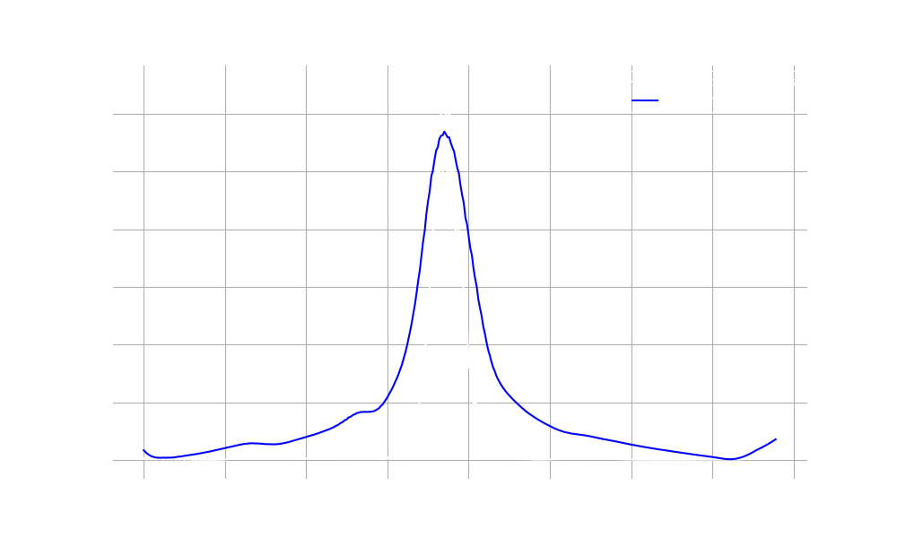
Respiration Detection: Bin Selection
Variance Across Bins with Smoothed Envelope
Notes:
Bin 188 was detected to have the most variance
Distance axis calculated using range resolution: 2.996399 m
Automatically detected range of interest: 1.59 m to 1.81 m
Selected target_bin=188, distance ~ 1.70 m

Slide 18
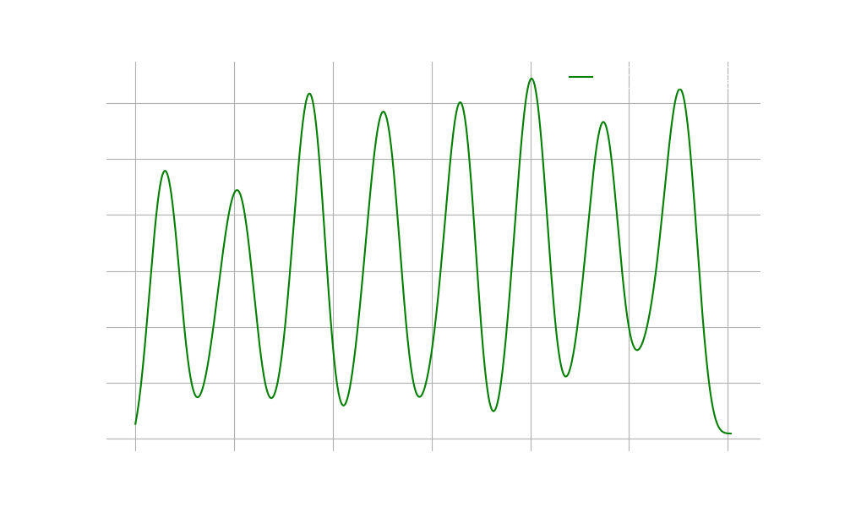
Respiration Detection: Envelope Extraction
Envelope Extraction Diagram

Slide 19

Respiration Detection: Filtered signal
Frequency Spectrum of Filtered Respiration Signal

Slide 20

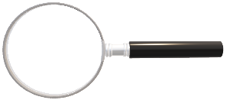
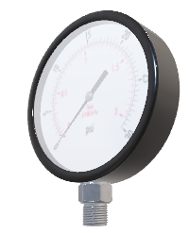
3rd Experiment: Sleep Apnea Detection
Hardware Components
Radar Specifications
Experiment Layout and Workflow
Processing Techniques and Analysis
Raspberry Pi: for initial data storage and preprocessing before export to PC
Radar Module
PC: for further data processing and analysis
Center Frequency (fc): 7.29 GHz
Bandwidth (B): 2.5 GHz
Sampling Rate (fs): 23.328 GHz
Pulse Repetition Frequency (fF): 30 Hz
Initialization
Operation:
Radar Operation: 1min
Activity: Subject sleeps
Data Collection
Data Analysis
Signal Cleaning and Target Selection: Clutter removal and variance-based bin detection
Signal Analysis: Bandpass filter and Hilbert envelope extraction
Notes:
For this experiment, we used the same radar hardware setup as in prior respiration detection experiments.

Slide 21
3rd Experiment: Sleep Apnea Detection
Hardware Components
Radar Specifications
Experiment Layout and Workflow
Processing Techniques and Analysis
Raspberry Pi: for initial data storage and preprocessing before export to PC
Radar Module
PC: for further data processing and analysis
Center Frequency (fc): 7.29 GHz
Bandwidth (B): 2.5 GHz
Sampling Rate (fs): 23.328 GHz
Pulse Repetition Frequency (fF): 30 Hz
Initialization
Operation:
Radar Operation: 1min
Activity: Subject sleeps
Data Collection
Data Analysis
Signal Cleaning and Target Selection: Clutter removal and variance-based bin detection
Signal Analysis: Bandpass filter and Hilbert envelope extraction
Notes:
The hardware includes a radar module connected to a Raspberry Pi and a PC for data processing.

Slide 22
3rd Experiment: Sleep Apnea Detection
Hardware Components
Radar Specifications
Experiment Layout and Workflow
Processing Techniques and Analysis
Raspberry Pi: for initial data storage and preprocessing before export to PC
Radar Module
PC: for further data processing and analysis
Center Frequency (fc): 7.29 GHz
Bandwidth (B): 2.5 GHz
Sampling Rate (fs): 23.328 GHz
Pulse Repetition Frequency (fF): 30 Hz
Initialization
Operation:
Radar Operation: 1min
Activity: Subject sleeps
Data Collection
Data Analysis
Signal Cleaning and Target Selection: Clutter removal and variance-based bin detection
Signal Analysis: Bandpass filter and Hilbert envelope extraction
Notes:
The radar's specifications and operating conditions remained consistent with prior experiments.

Slide 23
3rd Experiment: Sleep Apnea Detection
Hardware Components
Radar Specifications
Experiment Layout and Workflow
Processing Techniques and Analysis
Raspberry Pi: for initial data storage and preprocessing before export to PC
Radar Module
PC: for further data processing and analysis
Center Frequency (fc): 7.29 GHz
Bandwidth (B): 2.5 GHz
Sampling Rate (fs): 23.328 GHz
Pulse Repetition Frequency (fF): 30 Hz
Initialization
Operation:
Radar Operation: 1min
Activity: Subject sleeps
Data Collection
Data Analysis
Signal Cleaning and Target Selection: Clutter removal and variance-based bin detection
Signal Analysis: Bandpass filter and Hilbert envelope extraction
Notes:
Although the experiment's exact background layout wasn't disclosed, we know that the data was collected for a duration of 5 minutes, or 300 seconds and the subject was sleeping. The experiment layout remains consistent across all three experiments

Slide 24
3rd Experiment: Sleep Apnea Detection
Hardware Components
Radar Specifications
Experiment Layout and Workflow
Processing Techniques and Analysis
Raspberry Pi: for initial data storage and preprocessing before export to PC
Radar Module
PC: for further data processing and analysis
Center Frequency (fc): 7.29 GHz
Bandwidth (B): 2.5 GHz
Sampling Rate (fs): 23.328 GHz
Pulse Repetition Frequency (fF): 30 Hz
Initialization
Operation:
Radar Operation: 1min
Activity: Subject sleeps
Data Collection
Data Analysis
Signal Cleaning and Target Selection: Clutter removal and variance-based bin detection
Signal Analysis: Bandpass filter and Hilbert envelope extraction
Notes:
To process the radar data, we first removed background noise using clutter removal and selected the most active bin for respiratory activity using variance-based bin detection.
The signal was further analyzed using a bandpass filter to isolate respiratory frequencies and the Hilbert transform to compute the signal envelope for detecting apnea events.

Slide 25
Sleep Apnea Detection: Detailed Processing Techinques
Clutter Removal
Variance-Based Bin Selection
Bandpass Filtering
Envelope Extraction Using the Hilbert Transform
Thresholding
Notes:
Clutter Removal
Radar data often includes static background noise. Clutter removal subtracts the mean signal across all bins to isolate dynamic changes caused by respiration
Variance-Based Bin Selection
The radar captures data across range bins. To identify the most prominent bin for respiratory activity, we calculated the variance of the signal in each bin and selected Bin 77, which had the highest variance. This approach ensures we focus on the most active bin for apnea detection
Bandpass Filtering
Breathing typically occurs within a frequency range of 0.1 to 0.6 Hz, corresponding to 6 to 36 breaths per minute. A bandpass filter isolates this range, reducing noise from unrelated motion or static signals
Envelope Extraction Using the Hilbert Transform
The Hilbert transform computes the envelope of the filtered signal. This envelope represents the signal's amplitude over time, which correlates with the strength of respiratory motion. We use the envelope to detect periods of low activity, indicative of apnea events
Thresholding
We set a dynamic threshold using mean−(0.2×std) of the envelope. Apnea is detected when the envelope drops below this threshold for at least 7 seconds, ensuring that only significant events are classified as apnea

Slide 26
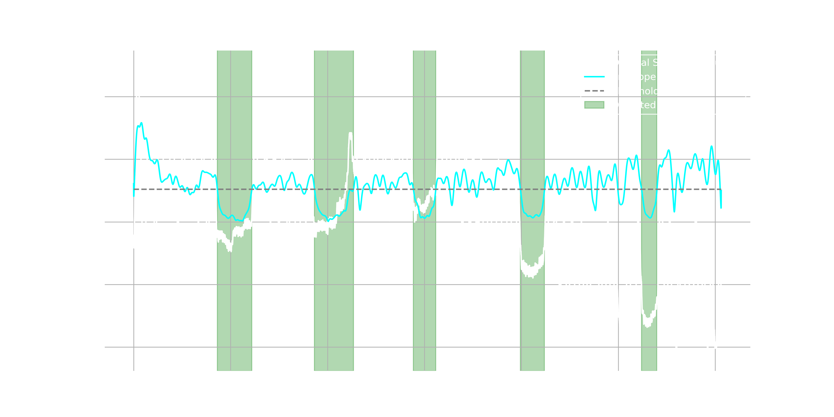
Sleep Apnea Detection: Results
 | Started | Duration
First | 43.2 | 17.8
Second | 93.3 | 20.1
Third | 144.3 | 11.5
Fourth | 199.5 | 12.5
Fifth | 262 | 7.9
 | Started* | Duration*
First | 42.97 | 18
Second | 93.4 | 16
Third | 144.9 | 11
Fourth | 200.1 | 11
Fifth | 262.3 | 7.5
Detection of Sleep Apnea Diagram
*Results from supervisor’ slides
Notes:
This graph illustrates the original radar signal, the computed envelope, and the detected apnea intervals (marked In green)
The five detected apneas closely match the reference results provided by the supervisor
Slight variatios in timing or duration could result from dynamic thresholding or preprocessing differences

